Slide 1

Child Poverty Session
Children & Young People Public Health Group
24 August 2017

Slide 2

Aims of the session
To get an update on the Child Poverty (Scotland) Bill;
To seek views on what should be included in the content of the statutory guidance on local child poverty action plan reports;
To provide summarised information on the causes of child poverty and current evidence base on effective interventions;
To share insights and experience from each other on advocating for/influencing child poverty as a local priority;
To consider what other type of support would be useful to access (e.g. data, outcomes planning, evaluation).

Slide 3

Programme
Welcome & introductions
Summary of child poverty in Scotland, its causes and consequences
Summary of evidence base
Child Poverty (Scotland) Bill update
- Stage 2 amendments
- Local child poverty action plan reports and potential support required
Advocating for/influencing child poverty as a local priority – shared insights and experience
Next steps

Slide 4

Child poverty in Scotland:
its causes and consequences

Slide 5
Outline
Scale of the issue, trends over time
Distribution of child poverty
Causes of child poverty
Consequences for health (inequalities)
Issues to consider

Slide 6
Scale of the issue
Latest measures of child poverty in Scotland
 | Absolute number | % | Year
Relative poverty | 260,000 | 26% | 2015/16
Absolute poverty | 230,000 | 23% | 2015/16
Combined material deprivation and low income | 110,000 | 12% | 2015/16
Persistent poverty | / | 12% | 2011-2015
Source: HBAI dataset, DWP 2015/16; Understanding Society, 2010-2015.
Notes:
This slide shows the number and percentage of children (under 16) in poverty in Scotland, aligned to the four headline income targets in the Child Poverty (Scotland) Bill.
Definitions
Relative: Household income less than 60 per cent of the median equivalised net income for that financial year
Absolute: Household income below 60 per cent of the median equivalised net income in 2010-11
Combined low income and material deprivation: Household income less than 70 per cent of the median equivalised net income for that financial year AND household has experienced material deprivation in that year (from a list, discussed in more detail in the SPICE briefing – only if parent reports they lack because they can’t afford, not because they don’t want them)
Persistent poverty: living in relative poverty at least three of the past four years
Source: Macpherson and Shaw (2017). SPICe Briefing: Child Poverty (Scotland)
Bill SP17-10. Available from: http://www.parliament.scot/ResearchBriefingsAndFactsheets/S5/SB_17-10_Child_Poverty_Scotland_Bill.pdf (which also gives a rationale for these targets)
In addition, the Scottish Household Survey (2015) suggests that 448,000 children (45%) live in households who ‘get by alright’ financially and 117,800 (12%) live in households who either don’t manage very well financially, have some financial difficulties or are in deep financial trouble.

Slide 7
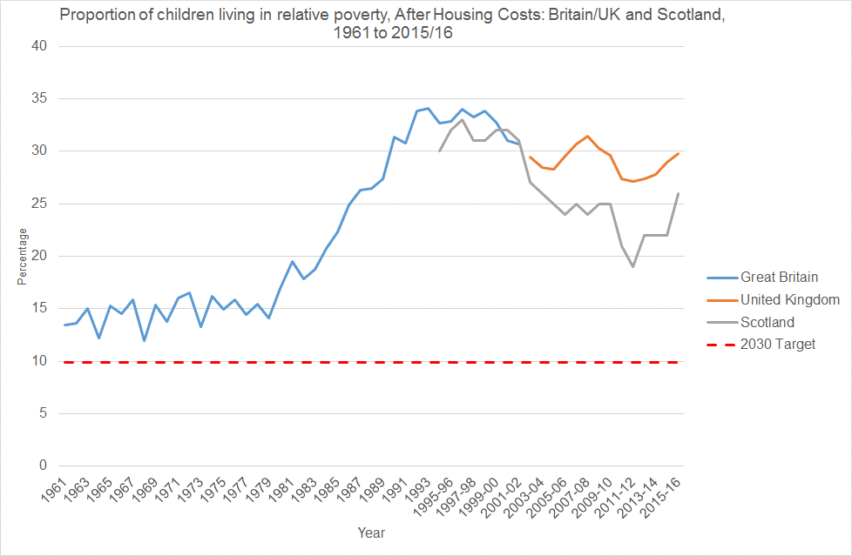
Trends over time
Source: Institute for Fiscal Studies; Scottish Government (based on DWP HBAI data).
Notes:
The blue line shows trends for Great Britain, orange for UK (Great Britain plus Northern Ireland), while the grey line shows Scotland. The measure is relative poverty after housing costs.
In Britain, relative child poverty rates (after housing costs) fluctuated around ~ 15% during the 1960s and 1970s. Rates then saw a sustained increase in the 1980s from ~ 15% to ~ 33%, before fluctuating around this new, higher level for much of the 1990s. Child poverty rates in both Britain and Scotland then fell steeply from the late 1990s until the mid-2000s. After falling in the recession, child poverty rates began to increase again from 2011/12.

Slide 8
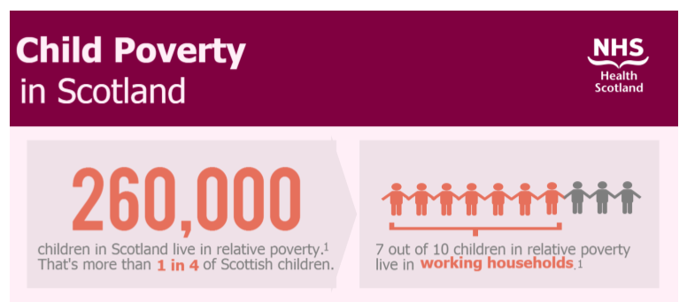
Who is affected? - 1
Source: Scottish Government (2017) 2015/16 Poverty and Income Inequality in Scotland: 2015/16
Notes:
Of the 260,000 children affected in Scotland 2015/16: a majority (70%) live in households where at least one adult worked, while just over 30% live in workless households.

Slide 9
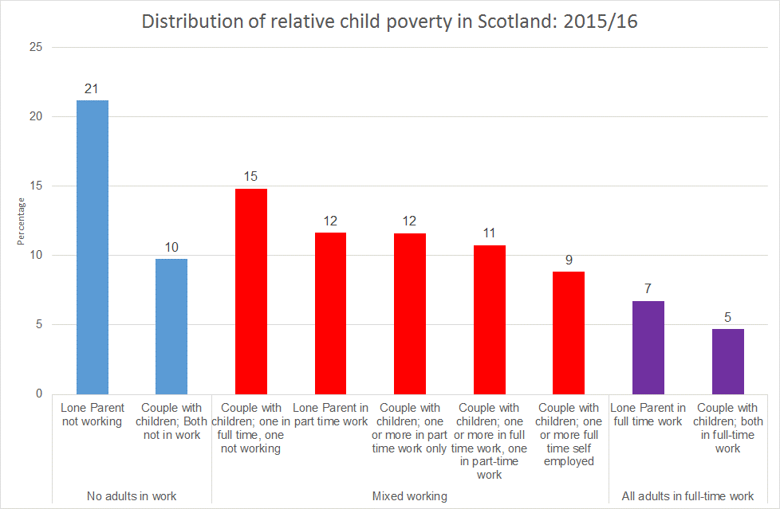
Who is affected? - 2
Source: HBAI dataset, DWP 2015/16
Notes:
Children living in poverty can be divided up in various ways. The chart shows the distribution of relative child poverty (After Housing Costs) in Scotland 2015/16, by household type and employment status of their parents. These sum to 100%.
Of the 260,000 children affected in 2015/16:
A majority (70%) live in households where at least one adult worked, while just over 30% live in workless households.
One in nine (11%) poverty lived in households where all the adults present worked full-time.
Around 40% of children in relative poverty live in lone parent households: just over half of these lived in workless households.
A quarter of children in poverty lived in couple households where one adult worked full-time but where the other either did not work or only worked part-time.

Slide 10
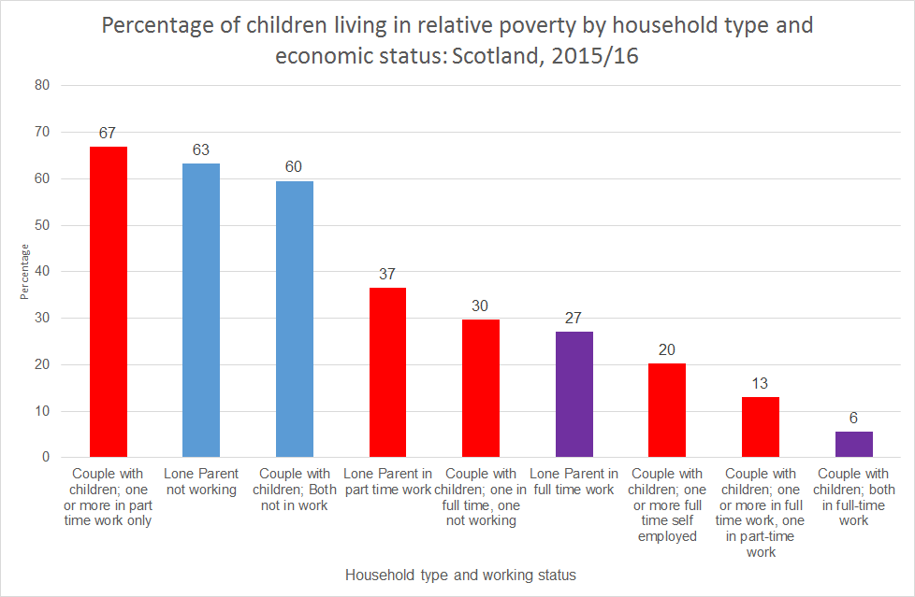
Who is affected? - 3
Source: HBAI dataset, DWP 2015/16
Notes:
Work is a more effective route out of child poverty where households contain two adults, both of whom are working and one of whom is working full-time.
This slide looks at the risk of relative poverty after housing costs for children in Scotland in 2015/16 within each household type – so for example, 60% of children living in couple households where neither parent works are in relative poverty.
Looking at the risk of child poverty by household type and employment status, the highest rates are observed for: children in part-time working couple households and children in workless households. Much lower rates are observed for couples where both parents are working. Only children in couple families where both parents are working full-time have a poverty rate of < 10%.

Slide 11
Who is affected? - 4
Source: Family Resources Survey
Notes:
Child poverty rates (after housing costs) are higher for children living in households with particular characteristics. The data shown here are for the UK. The chart gives the example of risk of relative poverty for children, by age of the youngest child in the household: this is highest for children living in households where the youngest child is aged 0-4 (35%) and lower for households where the youngest child is aged 5-10 (24%).
Child poverty risk is also higher for larger families (3 or more children), those living in households where someone is disabled (but the family does not receive disability benefits), those who rent, and children who live in households headed by someone whose ethnic group is non-white and non-Indian.

Slide 12
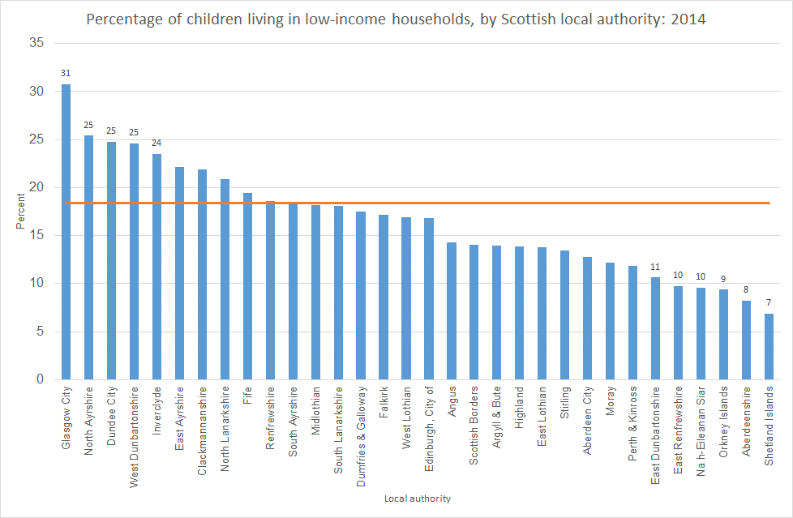
The geography of child poverty
Source: Giles and Richardson (2017), based on HMRC data.
Notes:
The percentage of children in low-income households is highest in Glasgow, Dundee, North Ayrshire, West Dunbartonshire and Inverclyde.
In relative terms, the proportion of children in low income households varied from 30.8% in Glasgow to <7% in the Shetland Islands.
In 2014, the largest number of children in low-income households in Scotland were in: Glasgow City (18.2), North Lanarkshire (8.1), Fife (7.6), Edinburgh (7.1%) and South Lanarkshire (6.2%). In most places, the share of children living in low-income households reflected the size of the local authority: however, Glasgow City stands out as having a higher share of children living in low-income households than might be expected given its share of all families with children.

Slide 13
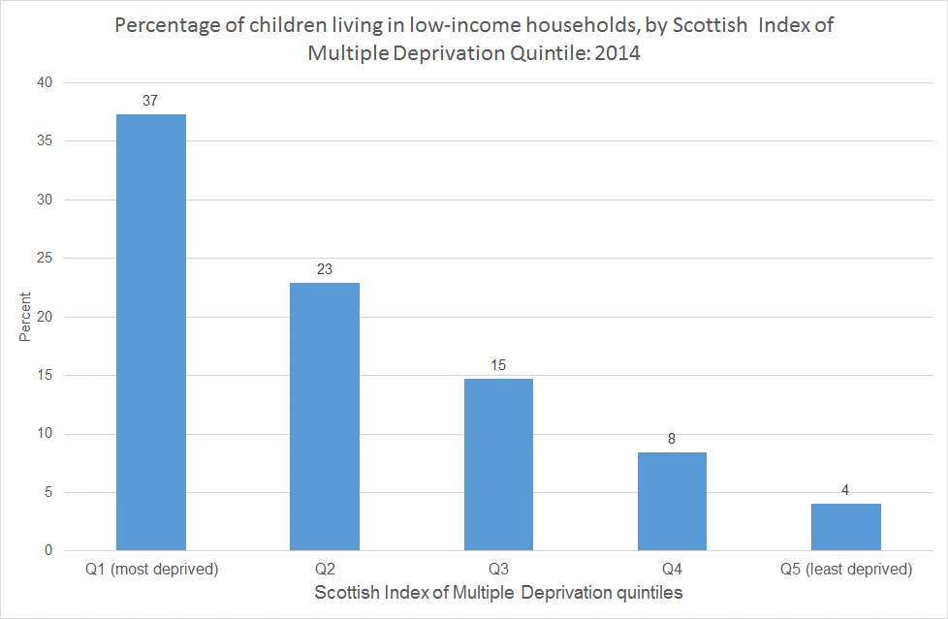
Child poverty risk and area deprivation
Source: Giles and Richardson (2017), based on HMRC data.
Notes:
While not all poor children live in deprived areas, the risk of poverty is much higher for children in those areas – and while poor children are also found in affluent areas, they are much less concentrated.
The forthcoming Children and Young People’s profiles (due for publication September 2017) also provides the risk of child poverty by SIMD quintile: in the most deprived quintile, 37.1% of children live in low-income households, while in the least deprived quintile, this falls to 4.1%.
Source: Giles L, Richardson E, ScotPHO Children and Young People’s Profile: National Overview Report. Edinburgh: NHS Health Scotland; 2017.

Slide 14

Scottish Government: drivers & solutions
Employment status
In-work poverty: wages, hours, insecurity, progression
Costs of living: housing, childcare, fuel
Social security benefits, including tax credits
Educational attainment (a dual role)
Underpinned by structural factors e.g. local and national housing and labour markets
Source: SG, Building the Evidence Base on Tackling Poverty (2017)
Notes:
The Scottish Government’s review of evidence highlighted the importance of structural factors in creating and sustaining poverty, including those driving in-work poverty.
The point was also made by the DWP analysis: “The main factor is lack of sufficient income from parental employment, which restricts the amount of earnings a household has. This is not just about worklessness, but also working insufficient hours and/or low pay”. (DWP Evidence Review, 2014).

Slide 15
The social security system
Source: DWP HBAI, various years.
Notes:
The risk of poverty for children varies by the types of (working-age) benefit received by the household – from ~ 14% where no benefits are being claimed to close to 90% for those in households claiming Job Seeker’s Allowance. For ESA/Income Support, the risk falls to around 60-64% and for child and working tax credits, 40-46%. Tax credits can help reduce the risk of poverty but it is notable that it is still high.
As the Cost of a Child in 2017 report notes: “For them [non-working families], the ‘safety net’ of means-tested support no longer merits this name, since it does not offer the safety of an income capable of covering essentials. Families unable to cover their costs on benefits must either undergo serious hardship, fall back on the help of their families or go into debt”.

Slide 16
The dark logic of UK Welfare Reform
Impact on lone parents and their children
In 2015/16 in Scotland, at least 2,656 lone parents sanctioned, against 961 job outcomes through Work Programme (Source: DWP).
“Four weeks with no money is pretty alarming when you’ve got kids and bills and a house to run.” (Patrick, 2017:131)
“They’re all right saying that [a sanction] is a punishment for not going in but what are me and my son meant to eat for the rest of that week? Really, they were quick enough to take our money but if that’s the only money we’re getting, what are we meant to do?” (Patrick, 2017:138)
Notes:
Interventions designed on the surface to improve health can cause harm. Part of UK’s welfare reform’s rationale was its assumed positive impact on the health of children. But the process has been as much geared towards cutting incomes as helping people improve their incomes through finding work.
Dwyer P, Bright J. (2016) First Wave Findings: Overview. Available at: http://www.welfareconditionality.ac.uk/wp-content/uploads/2016/05/WelCond-findings-Overview-May16.pdf
Patrick R. (2017) For Whose Benefit? The Everyday Realities of Welfare Reform. Policy Press: Bristol. p. 131, 138.
Bonell, Chris and Jamal, Farah and Melendez-Torres, G J and Cummins, Steven (2015) 'Dark logic' : theorising the harmful consequences of public health interventions. Journal of Epidemiology and Community Health, 69 (1). pp. 95-8. ISSN 0143-005X. DOI 10.1136/jech-2014-204671

Slide 17


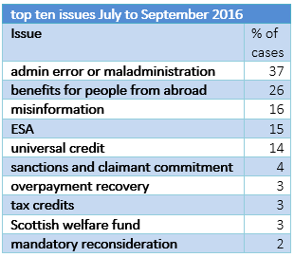
UK Welfare Reform
Source: CPAG Early Warning System.
Notes:
Benefit sanctions are however the tip of the iceberg – error and maladministration (including delays) are much more problematic…

Slide 18
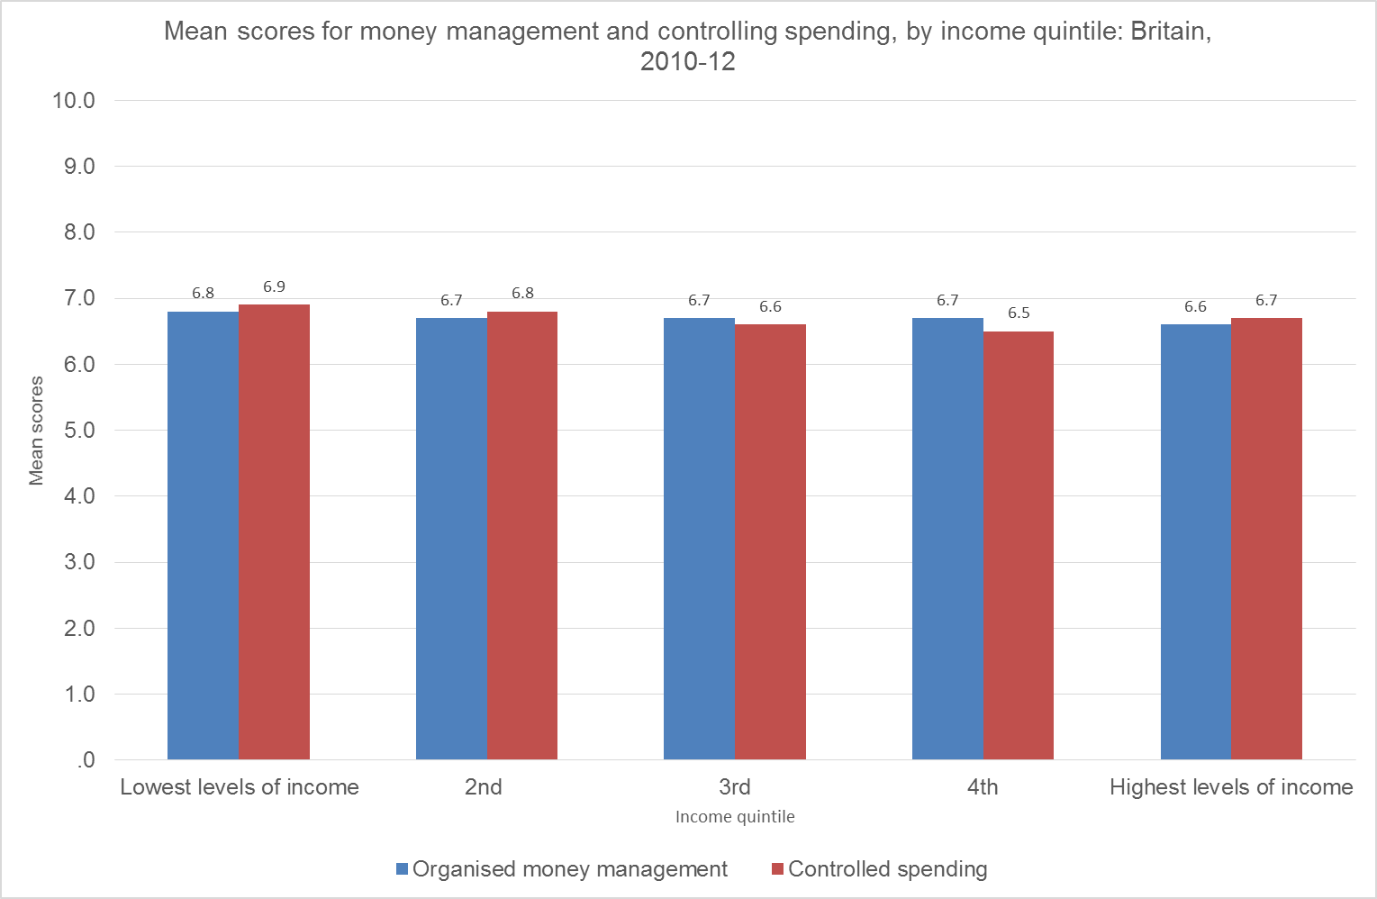
Financial management
Source: Finney & Hayes (2015), based on Wealth and Assets Survey 2010-12.
Notes:
Evidence from the wealth and assets survey shows that money management and controlling spending very similar across household income groups – bigger issues with making ends meet and planning ahead (saving).
Andrea Finney and David Hayes (2015) Financial capability in Great Britain: 2010 to 2012. ONS: London. Available from: https://www.ons.gov.uk/peoplepopulationandcommunity/personalandhouseholdfinances/incomeandwealth/articles/financialcapabilityingreatbritain/2015-06-24

Slide 19
Alternative perspectives?
Five ‘pathways to poverty’: family breakdown, educational failure, worklessness and dependency, addiction and serious personal debt (e.g. Centre for Social Justice)
A move away from a “fixation” with income measures
However:
  Conflation of cause, effect and measurement
  These measures do not help in measuring progress towards reducing child poverty.
  All the factors mentioned are a potential consequences of poverty (in childhood and adulthood), as much as causes.
  Some of them are future-orientated: action might help reduce the risk of poverty for children in the future, but will do nothing for child poverty now.
(Source: Stewart and Roberts, 2016)
Notes:
The Centre for Social Justice think-tank proposed five pathways to poverty (http://www.centreforsocialjustice.org.uk/policy/breakthrough-Britain).
For CASE paper, see:
Kitty Stewart and Nick Roberts (2016) How do experts think child poverty should be measured in the UK? An analysis of the Coalition Government’s consultation on child poverty measurement 2012-13. CASE: London.
On family breakdown – public health issue, child wellbeing issue; violence in the family, financial problems as a cause of relationship failure
Will discuss educational attainment and addictions later.
The Centre for Social Justice also resurrected the idea of ‘cycles’ of poverty, which is problematic:
“Poverty is not like syphilis or a biblical curse across the generations – poverty is not a disease and it cannot be caught and all creditable evidence shows that it is not ‘transmitted’ to children by their parents’ genes or culture… Children who grow up living in poverty are unsurprisingly more likely to suffer from poverty during their adult lives than their non-poor peers…any policy based on the idea that there are a group of ‘Problem Families’ who ‘Transmit’ their ‘Poverty/Deprivation’ to their children will inevitably fail, as this idea is a prejudice, unsupported by scientific evidence”
David Gordon and the PSE: UK research team (2011). ‘Consultation Response; Social Mobility & Child Poverty Review’, Policy Response Series No.2, Poverty and Social Exclusion in the UK.
Available from: http://www.poverty.ac.uk/system/files/WP%20Policy%20Response%20No.%202%20Consultation%20Resp%20Social%20Mobility%20&%20Child%20Poverty%20(Gordon%20Oct%202011).pdf

Slide 20
Scottish public opinion
What is the main cause of child poverty in Scotland today?
Their parents suffer from alcoholism, drug abuse or other addictions (29%)
Because of inequalities in society (16%)
Their parents do not want to work (13%)
Their parents have been out of work for a long time (10%)
Their parents' work doesn't pay enough (8%)
Source: Scottish Government (2015) Public Attitudes to Poverty, Inequality and Welfare in Scotland and Britain, p. 15
Notes:
While the Scottish public see drivers of child poverty as complex, parental addiction and lack of parental work ethic seen as very important. There is some recognition of low pay and inequalities (but unclear what the response might be). Alcohol and drugs are a huge problem for public health in Scotland and affect a lot of children but it is important to distinguish this from child poverty (and also perhaps acknowledge the limits of the data).
The data is shown here: http://www.gov.scot/Publications/2015/03/2695/4 (Table 1)

Slide 21
Consequences for health (inequalities)
Why does it matter?
 | Examples of risks
Direct, children today | Child social and emotional wellbeing Childhood obesity
Indirect, parental | Poorer parental mental health Passive smoking
Direct, long-term effects | Low(er) educational attainment Adult homelessness
Source: Cooper & Stewart (2017), Cooper & Stewart (2015), Bramley &
Fitzpatrick (2017),

Slide 22
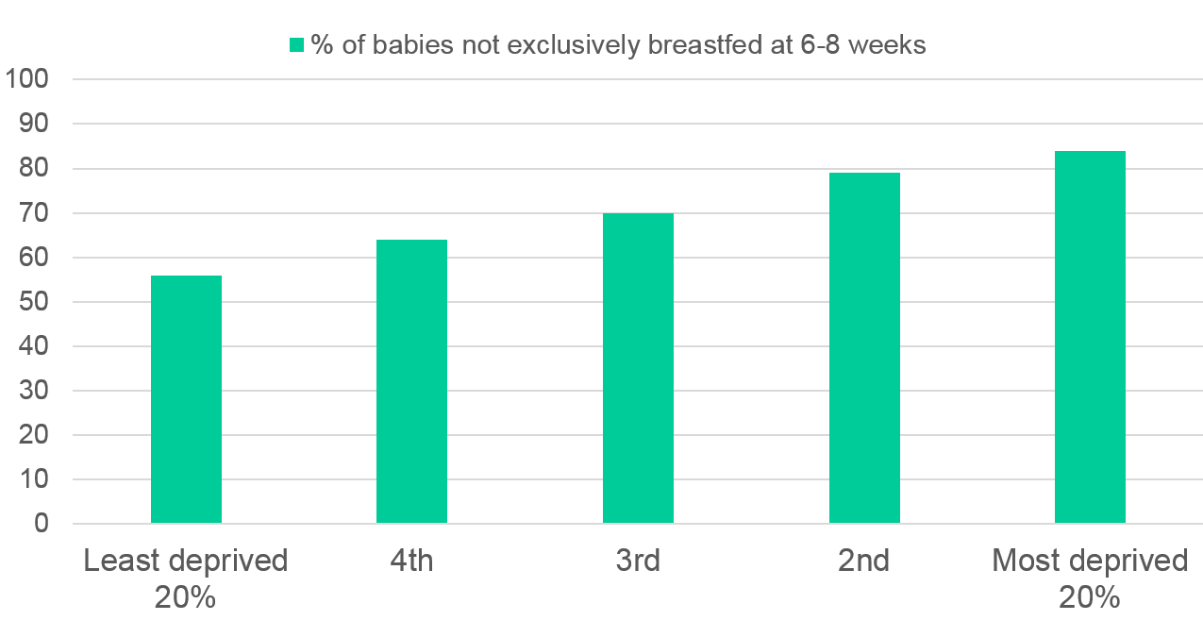
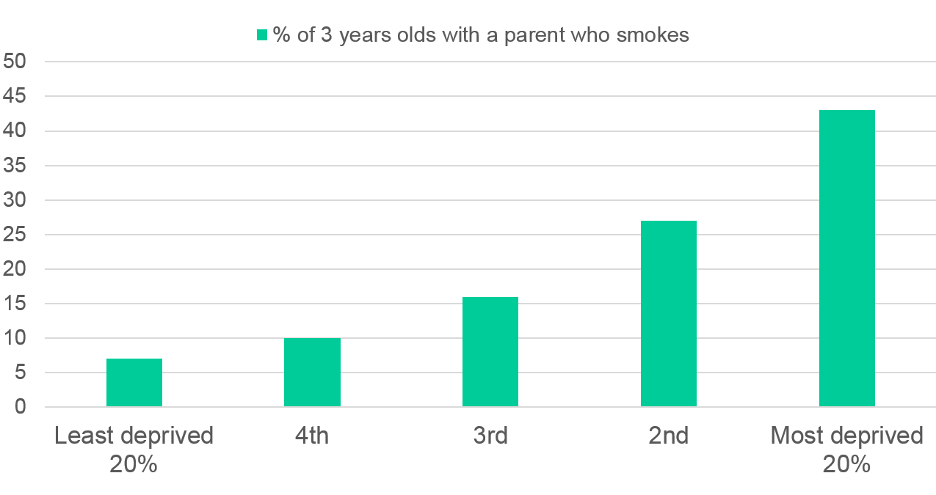
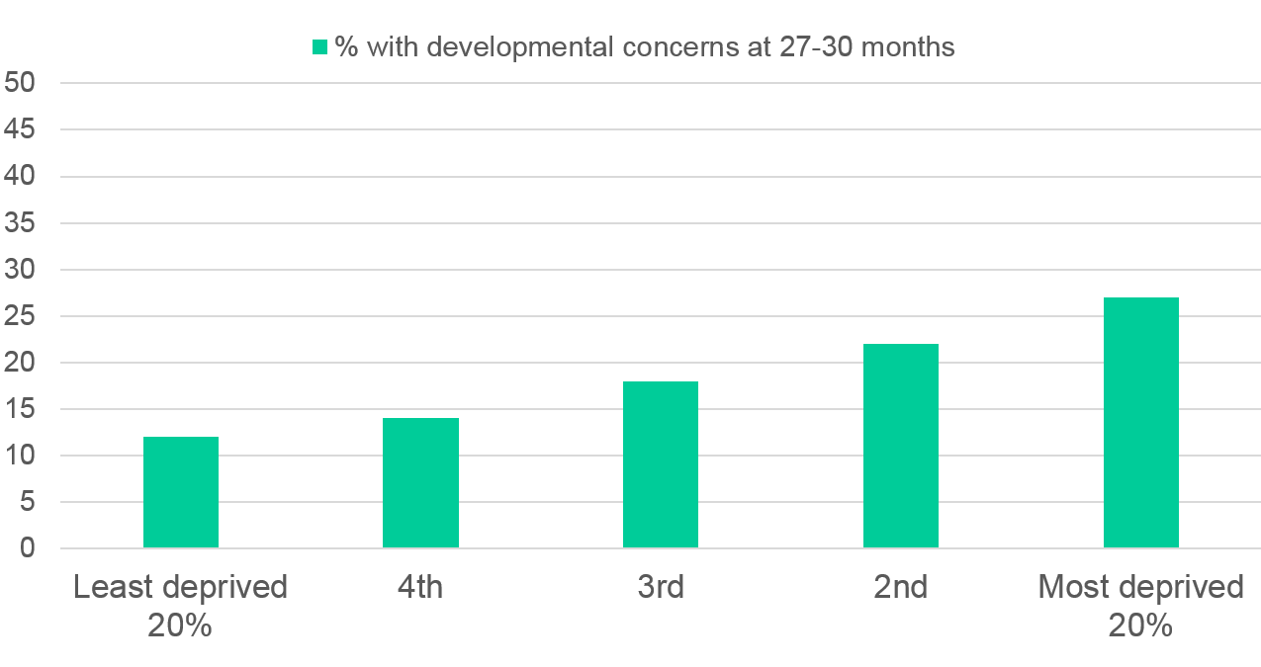
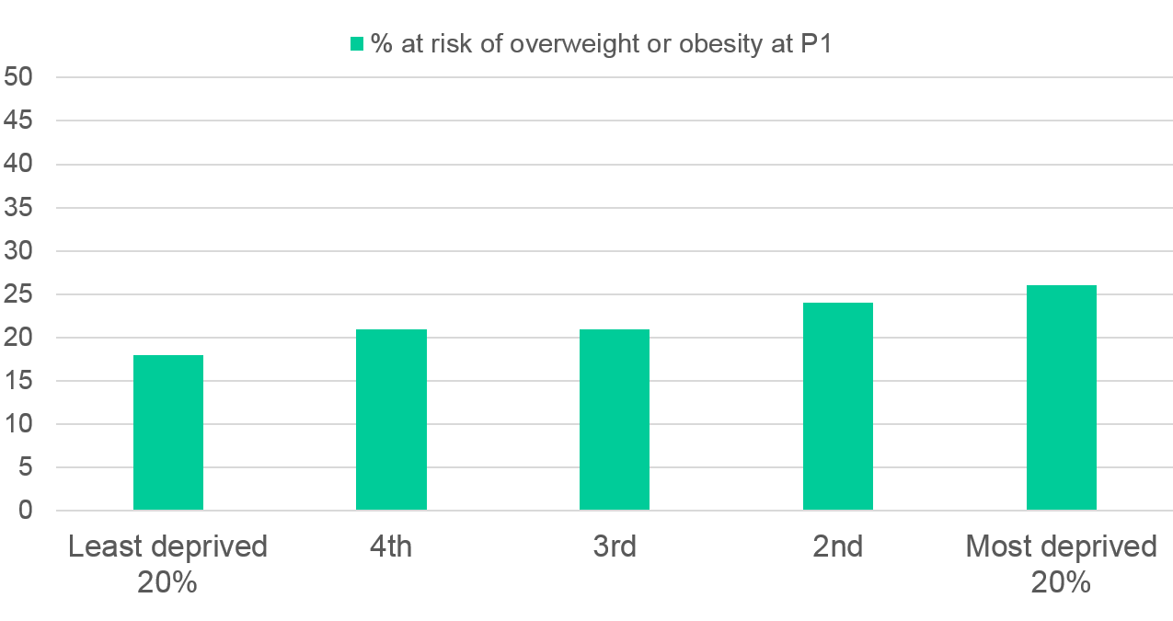
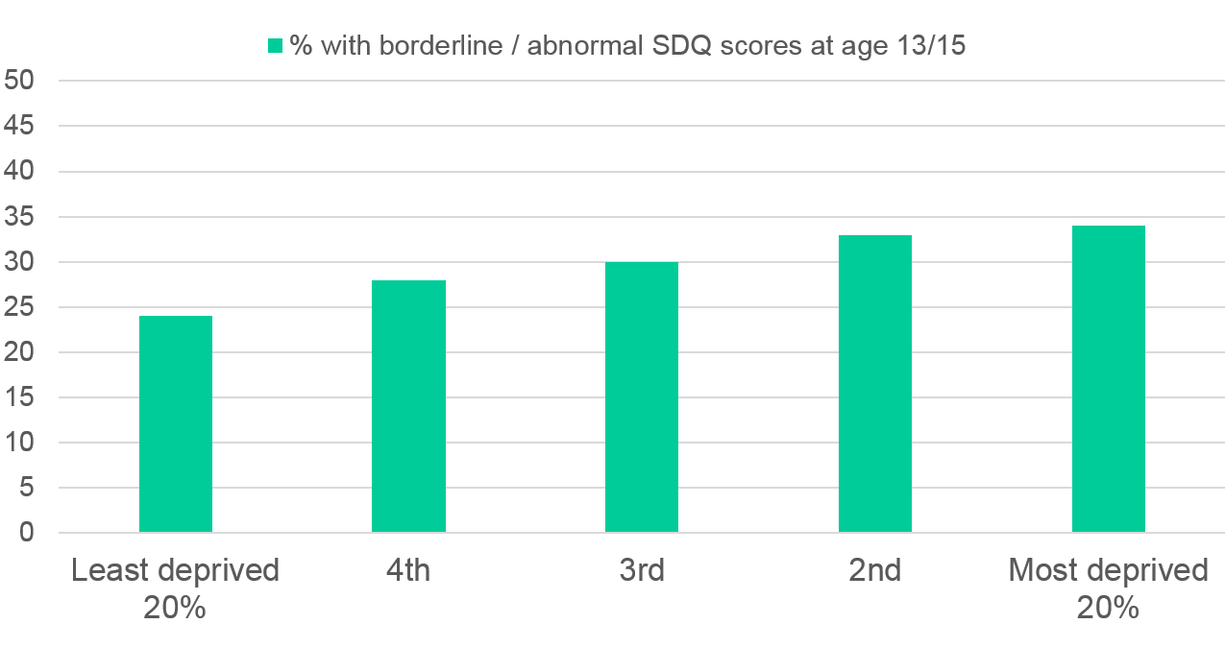
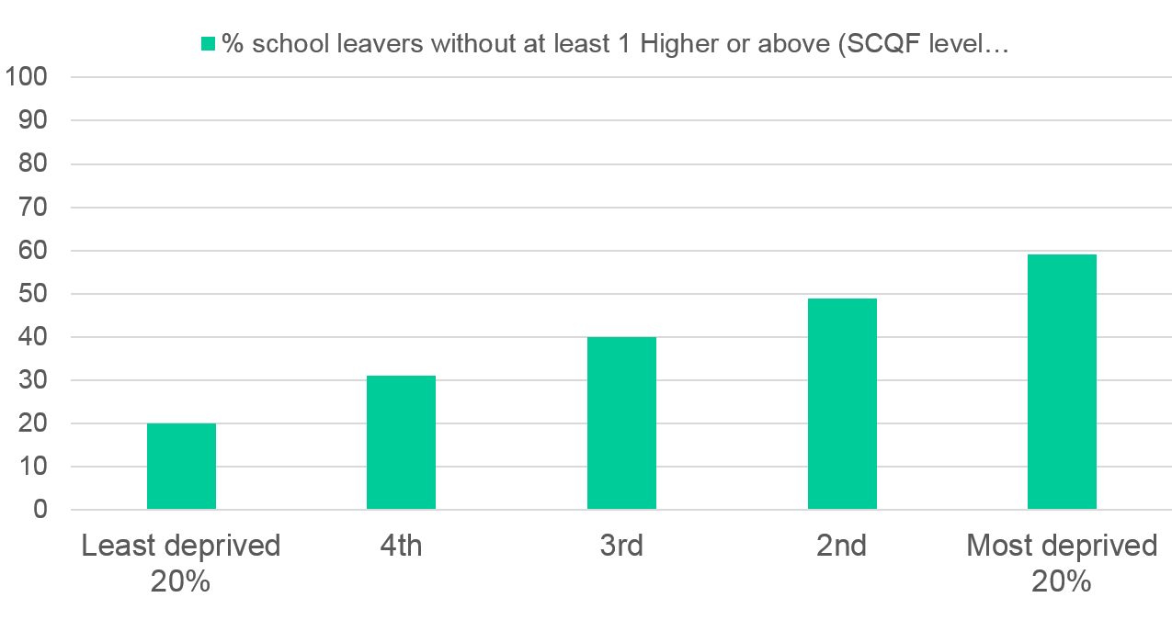
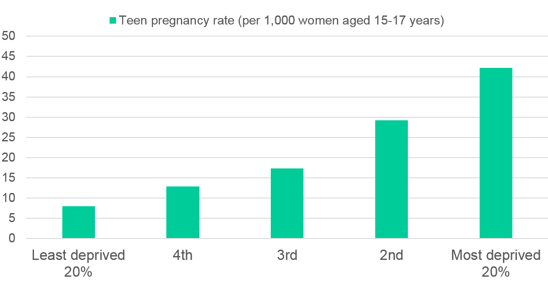
Cumulative impact
Notes:
Health inequalities are persistent at pre-birth, early years and adolescence and linked to income inequalities.
Although this data looks at outcomes for children and young adults by area deprivation quintile, it illustrates the staircase effect – children in more (less) deprived area have worse (better) outcomes in Scotland across a range of measures and at different points in their lives.

Slide 23
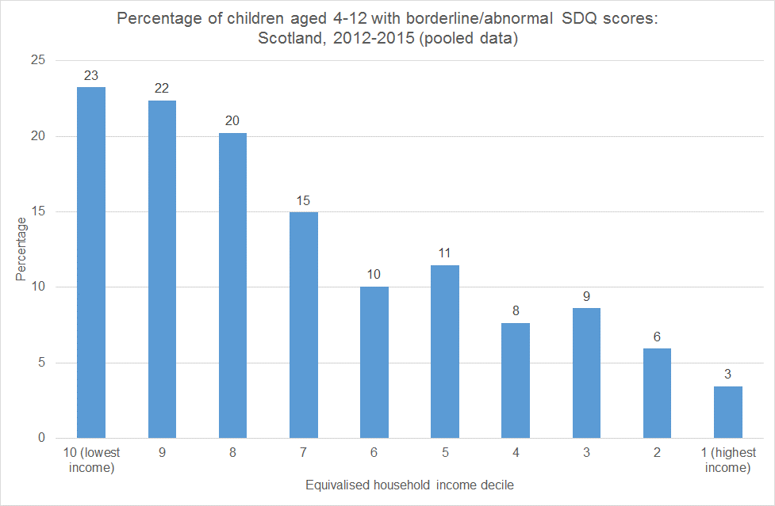
Child mental wellbeing & income
Source: Scottish Health Survey
Notes:
Although it is not possible to measure poverty on a direct, comparable basis using the Scottish Health Survey, the available data illustrates the association between household income and health outcomes and determinants highlighted above. Between a fifth and a quarter of children living in the bottom three income decile households have a borderline/abnormal SDQ score, compared to less than 10% in the top three income deciles.

Slide 24
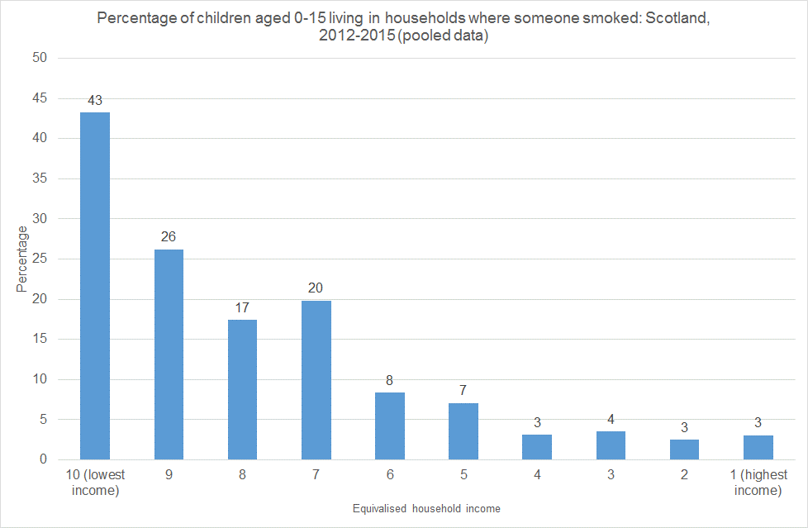
Children, passive smoking & income
Source: Scottish Health Survey
Notes:
Compared to their peers in the richest 10% of households, children in the poorest 10% of households are 14 times more likely to live in a household where someone smoked (43% vs. 3%).

Slide 25
Long-term risks
Homelessness
Using data from the British Cohort Study, Bramley and Fitzpatrick (2017) highlight the importance of childhood poverty in contributing to the increased risk of adult homelessness. They conclude:
“Our analysis also emphatically underlines the centrality of poverty to the generation of homelessness…action on addressing child poverty ought to be an overriding policy priority in this field” (Bramley and Fitzpatrick, 2017: 18-19)
Notes:
Glen Bramley & Suzanne Fitzpatrick (2017) Homelessness in the UK: who is most at risk?, Housing Studies, DOI: 10.1080/02673037.2017.1344957.

Slide 26
Long-term risks
Educational attainment
Analyses of Growing Up in Scotland found that by age 5, children in low-income households had vocabulary development that was 13-months behind and problem solving that was 10 months behind that of children living in high-income households (Bradshaw, 2011).
In their review of the educational gap in Scotland, Sosu and Ellis (2014) note that: "If schools are to close the gap, they must be supported by anti-poverty strategies aimed at reducing income inequality....A key message for Scotland is that reducing the attainment gap must involve concrete strategies that increase income levels to families living in poverty." (Sosu and Ellis, 2014: 38)
Notes:
Edward Sosu and Sue Ellis (2014) Closing the Education Gap in Scottish Education. Joseph Rowntree Foundation: York.
Bradshaw, P. (2011) Growing up in Scotland: Changes in child cognitive ability in the pre-school years, Edinburgh: Scottish Government

Slide 27

ScotPHO Profiles
Will be launched end September 2017:
  Updated Children and Young People's Profiles
  Community Health and Wellbeing profiles (2011 DZs)
Notes:
Profiles available from ScotPHO, 28th September: https://scotpho.nhsnss.scot.nhs.uk/scotpho/homeAction.do

Slide 28
Questions?

Slide 29



Slide 30

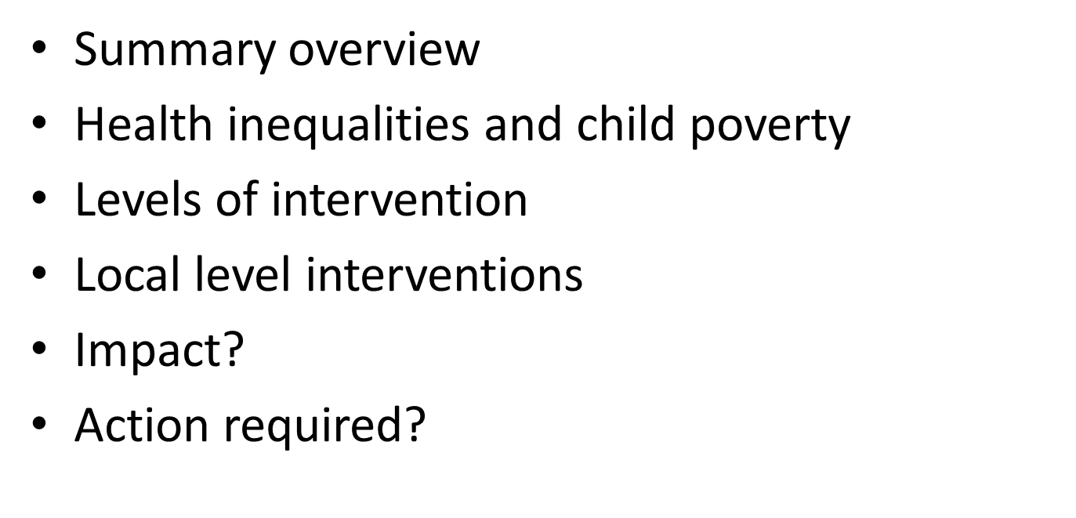
Notes:
This presentation will briefly cover the causes and consequences of child poverty – most of which has been covered in the previous talk.
It will also look at some of the main causes of health inequalities and how this relates to child poverty
It then looks at what level interventions can be delivered i.e. UK Government level down to local level
Look briefly at some interventions which Local Authorities or CPPs have the power to deliver
Also need to look at what the impact of interventions are and what we know id effective
And finally a call to action to tackle child poverty as responsibility lies across many sectors and organisations

Slide 31
Causes of Child poverty
Employment status
In-work poverty: wages, hours, insecurity, progression
Costs of living: housing, childcare, fuel
Social security benefits, including tax credits
Educational attainment (a dual role)
Underpinned by structural factors e.g. local and national housing and labour markets
Individual factors: fitness to work, skills and qualifications
Notes:
As mentioned in Martins presentation, some of the key causes of child poverty include:
Employment status -The risk of relative poverty increases as the number of hours a household works decreases, and particularly when households move into unemployment. Employment is not, however, a guaranteed route out of poverty
Hourly pay and hours of work - Low paid workers face a higher risk of poverty than workers who are not on a low hourly pay
Working conditions - Temporary and insecure employment is also related to relative poverty, because it reduces work duration. Research has suggested that the experience of being unemployed is not normally one of long-term unemployment or work avoidance, but of fluctuating between low-paid, short-term employment and unemployment
Cost of living - Need high quality flexible and affordable childcare which allows parents to return to work (full-time) or study
Benefits - Families need to be able to access all the benefits they are entitled to – need financial inclusion support
In terms of individual factors and employability, people need both the physical and mental ability to take up employment as well as having necessary qualifications and skills to enter “worthwhile” work which lifts people out of poverty.

Slide 32
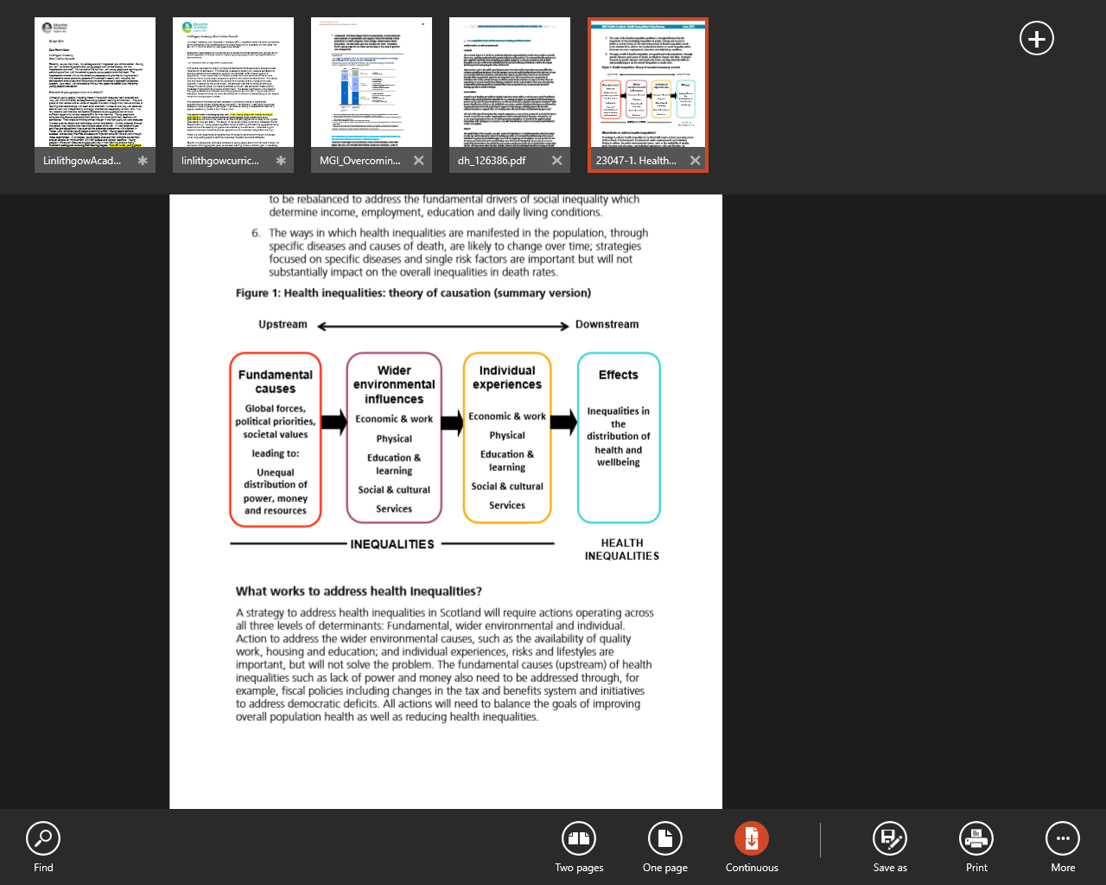
Health Inequalities: theory of causation
Notes:
What do we mean by health inequalities?
Health inequalities are: Unfair differences in health within the population across social classes and between different populations. These unfair differences:
Are not random, or by chance, but largely socially determined
Are not inevitable.
What causes health inequalities?
Income: money received by individuals or groups over a specific time period.
Power: This is a complex concept which includes the ability or capacity to do (or not to do) something and control, force or influence through a variety of means.
Wealth: Accumulated material and capital assets which provides a reserve of financial resources and often provides an income stream (e.g. from interest, rents and share dividends)
Wider environmental influences – this is where “prevention” interventions are most applicable
Individual experiences – this is where “mitigation” interventions are most applicable (see later slides)
Fundamental causes – The “undo” interventions could target this area but is global.
What is most and least effective in reducing health inequalities?
Most likely to be effective
Structural changes to the environment; legislation, regulatory and fiscal policies; income support, reduced price barriers; accessibility of public services, prioritising disadvantaged groups and individuals; intensive support for disadvantaged population groups; starting young.
Least likely to be effective
Interventions reliant on people opting in; information based campaigns; written materials; messages designed for the whole population; interventions that involve significant price or other barrier

Slide 33
Levels of interventions
UK level state interventions – welfare, taxation, benefits
Devolved (Scottish) e.g. welfare powers to mitigate against unfair UK welfare – bedroom tax; housing, education, childcare
Local actions – those which LA and CPPs have the power to deliver to local populations: services, education, employment
Notes:
UK Government changes to welfare system likely to reduce overall level of financial support to those in need.
Devolved tax and benefits within Scottish Government power can help reduce the impact of UK welfare changes.
Local actions - actions which local authorities, CPPs, third sector and voluntary groups can take to reduce or mitigate the likelihood of poverty

Slide 34
Types of intervention:
Prevent, Mitigate, Undo
Three approaches to reducing (child) poverty and health inequalities:
Prevent - across national and local services and sectors
Mitigate - across local service provision and response
Undo - UK and Scottish Government level actions
Notes:
NHS Health Scotland has developed a Theory of Causation model that sets out the type of activity that would undo, prevent and mitigate health inequalities. This could be applied in the context of child poverty and highlight who is best placed to take which action and at what level and what is the balance of effort required. Much of the undo action is national at SG and UK level; prevention across national and local services/sectors and mitigation local across service response in the main. Legislation at a national level might then require statutory requirement at a local level for some aspects. This would be helpful as where there are funding pressures within the public sector system, non-statutory activities are at risk.
To eradicate child poverty, this would mean moving beyond mitigating child poverty at the margins to preventing and undoing child poverty more directly. To do so may require more radical actions at a national level

Slide 35
Strategies to reduce child poverty
Mitigation and prevention
Income maximization and employment
Education
Childcare
Lone parenthood
Other important areas: health, disability, housing, transport, food insecurity, human rights, knowledge (McKendrick)
Notes:
Lots of actions at local level to support families to access benefits/entitlements
Income maximisation
provide local accessible money advice services
increase uptake of benefit entitlements
advice on fuel, housing, debt management prevent or mitigate the effects of benefit sanctions
support for parents entering or returning to employment
reduce the poverty premium.
Education and schools
free school meals
uniform grants
reduce stigma to access these services
look at reducing other school costs such as day trips
summer school camps (meals/inclusion)
Childcare
access to high quality affordable, flexible childcare provision
access funding or free entitlement for 3 and 4 year olds (as well as some 2 year olds)
Take account of the needs of lone parents
council support services
work support
childcare
education
Other key areas for intervention include direct actions to improve health, housing (quality and costs), transport - especially in rural areas and after school time ends for people travelling some distance so miss out on after school activities.

Slide 36
Examples of Local Authority and CPP actions to provide sufficient income support to keep families out of poverty
Provide financial inclusion support to parents to access all eligible benefits
Provide affordable housing of good quality
Provide free or affordable, high-quality flexible early learning and childcare
Provide affordable public transport for parents and children in poverty
Reduce the cost of the school day
Protect investment in early years services
Support parents into fair employment in order to maximise household incomes
Identify areas and groups with the greatest needs
Tackle in-work poverty, through the introduction of a true living wage
Help reduce the poverty premium
Notes:
Lots of potential areas for action:
Some of the key actions recommended in the Marmot review include:
▸ protecting investment in early years services;
▸ shifting expenditure towards the early years wherever possible;
▸ providing high-quality and consistent support and services for parents during pregnancy;
▸ provision of high-quality universal services in childhood;
▸ routine support to families through parenting programmes, children’s centres and key workers,
▸ providing support so that all children can access a healthy diet in the early years;
▸ providing high-quality home visiting services;
▸ focusing on narrowing the educational attainment gap at all stages.
Among the factors in the child poverty pyramid (DWP) which CPPs can influence directly or indirectly are: accessible or subsidised sporting or cultural activities; free school meals; local environmental improvements which directly impact on children (such as the provision of accessible, quality public space); improved local transport; reducing fuel poverty; promoting financial inclusion; increasing the availability of childcare that at the same time enriches children’s lives (rather than that which is only concerned to facilitate parents’ participation in the labour market); providing social services support for at risk children, and improving access to advice on financial issues and benefits.
In all of these areas CPPs and other local agents acting independently can increase households’ disposable income (by reducing necessary spend) and reduce child deprivation in important respects, and could be considered as part of a child poverty strategy

Slide 37
NHS and health inequalities
In terms of reducing health inequalities:
Provide quality services with allocation of resources proportionate to need
Training the NHS workforce to understand their role in reducing inequalities
Effective partnership with different sectors to help reduce health inequalities
Mitigation of inequalities through employment and procurement processes
Advocating to reduce health inequalities
Notes:
NHSHS role of NHS in tackling health inequalities 2017
Services - NHS usually in contact (first contact often) with children who have a disability, or adult with long term condition or illness as well as vulnerable adults and children
Workforce – tackling child poverty everyone's responsibility – making staff aware of causes and consequences of poverty and how to identify and help reduce it
Partnership - Proven examples of financial inclusion – mitigation through the Healthier Wealthier Children intervention with partner organisations
Ensuring staff are payed a fair wage, contracts, employment opportunities and support where needed

Slide 38
Examples of good practice
The Healthier, Wealthier Children (HWC) project
The Cost of the School Day
Free School Meals policy
Summer school camps
Notes:
The Healthier, Wealthier Children (HWC) project developed referral pathways between early years health service and money advice services for pregnant women and families with young children who were experiencing or at risk of child poverty
The Cost of the School Day study was carried out in Glasgow and involved an in-depth evaluation of the cost barriers and burdens that school can place on families and how these can exclude young people from participating in the school experience
Free School Meals policy is the introduction of universal free school meals (UFSM) across Scotland for all children in the first three years of primary school. The new policy aims to support child development, tackle poverty and improve educational attainment
Summer camps – provides activities and healthy meals during holiday time for vulnerable children

Slide 39
Impact of actions
Difficult to assess impact of local actions – few robust or published evaluations
Lots of examples of good practice but less so of effectiveness
High level (state) interventions may have greater overall impact on child poverty than local actions?
Notes:
Caution is required before making recommendations about local child poverty policy. In particular, not all of what has been claimed as ‘best practice’ and evidence of ‘success’ presented in the literature in this field has been independently verified.
In some cases, such evidence would be best described as ‘what has been tried’ rather than ‘what has been proven to work’ (Sinclair, S. & McKendrick, J.H., 2014. Tackling child poverty locally: principles, priorities and practicalities in challenging times. Scottish Affairs, 23(4), pp.454–485. Available from: http://www.euppublishing.com/doi/abs/10.3366/scot.2014.0044)
It is clear that no single factor nor measure which is introduced will eradicate child poverty or ameliorate its effects - improving one outcome in isolation from others is unlikely to be successful’ . Interventions which are narrowly targeted on particular aspects of child poverty are unsuccessful if they fail to take into account factors such as wider family circumstances.
The European Union has recommended that the most effective response to child poverty is a multidimensional approach based on three pillars: access to adequate resources; access to quality services and opportunities, and ensuring that children’s views and experiences are taken into account in developing policies that affect them (EU Presidency, 2010)
And although LA and CPPs deliver a lot of good work in targeting child poverty, its not clear if this has more impact than interventions delivered at a national level.

Slide 40
Summary
Lots of potential areas for action by different organisations – LA, NHS, public, private and voluntary sector
Needs a wide holistic approach – targeting many of the causes of child poverty simultaneously
Vulnerable people need identified early to allow for prevention or mitigation

Slide 41
Local partnership action
Public , private and voluntary sectors need to work in partnership to provide the knowledge and actions on what works to help reduce the levels and consequences of child poverty in Scotland
How can we improve the evidence base for local action?
Notes:
This is a call to action – any effort to reduce child poverty needs partnership working, sharing of best practice and identifying what works through robust evaluation.

Slide 42
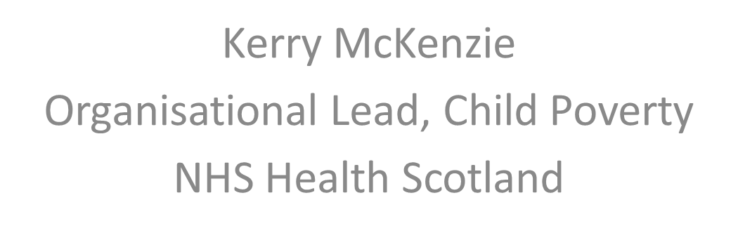
Child Poverty (Scotland) Bill update

Slide 43
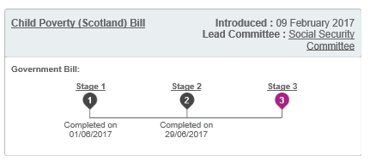
Child Poverty (Scotland) Bill
http://www.parliament.scot/Child%20Poverty%20(Scotland)%20Bill/SPBill06AS052017.pdf

Slide 44
Child Poverty (Scotland) Bill
Four statutory, income-based targets to be achieved by 2030:
  Less than 10% of children are in relative poverty.
  Less than 5% of children are in absolute poverty.
  Less than 5% of children are in combined low income and material deprivation.
  Less than 5% of children are in persistent poverty.
All four targets are after housing costs.
SG to produce a series of Delivery Plans and report progress to Parliament
Duty on local authorities and health boards to report annually on activity to contribute to reducing child poverty.
Notes:
Definitions
Relative: Household income less than 60 per cent of the median equivalised net income for that financial year
Absolute: Household income below 60 per cent of the median equivalised net income in 2010-11
Combined low income and material deprivation: Household income less than 70 per cent of the median equivalised net income for that financial year AND household has experienced material deprivation in that year (from a list, discussed in more detail in the SPICE briefing – only if parent reports they lack because they can’t afford, not because they don’t want them)
Persistent poverty: living in relative poverty at least three of the past four years
Source: Macpherson and Shaw (2017), SPICe Briefing: Child Poverty (Scotland) Bill SB17-10.
Available from: http://www.parliament.scot/ResearchBriefingsAndFactsheets/S5/SB_17-10_Child_Poverty_Scotland_Bill.pdf (which also gives a rationale for these targets)

Slide 45
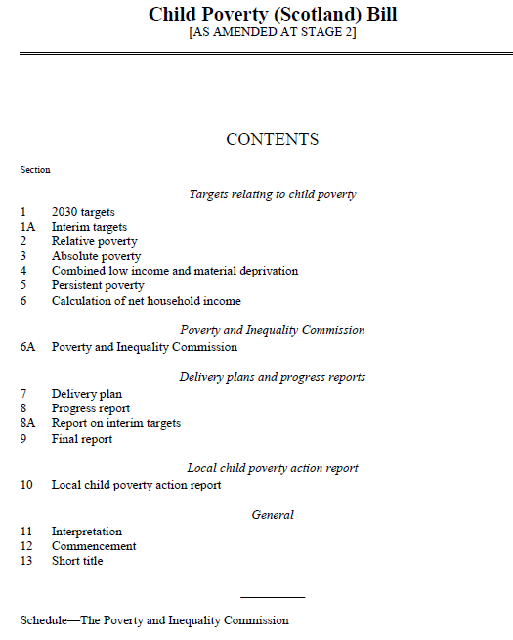
Child Poverty (Scotland) Bill
Interim targets
Delivery Plan
Local action report
Poverty & Inequality Commission
Stage 3 - November
Notes:
The main amendments passed at stage 2 include:
Interim targets on the face of the Bill, to be met by 2023/24; these are calculated based on the mid-point between 2015/16 levels and the 2030 target.
Key areas which must be covered in the Child Poverty Delivery Plans which the Scottish Government will now require to produce; these are set out below.
A forward looking aspect to Local Child Poverty Action Reports, with Local Authorities and Health Boards now required to outline action they propose to take in future years.
The establishment of a statutory Poverty & Inequality Commission.

Slide 46
Local child poverty action plan reports
A local authority and each relevant Health Board must, as soon as reasonably practicable after the end of each reporting year, jointly prepare and publish a report
- must describe any measures taken and proposed
must, in particular, describe income maximisation measures taken in the area of the local authority during the reporting year to provide pregnant women and families with children
(a) information, advice and assistance about eligibility for financial support, &
(b) assistance to apply for financial support.

Slide 47
Local child poverty action plan reports
Statutory guidance in development
Members of the C&YP PH Group on reference group
Opportunity to influence and advise
Template approach ? How much prescription?
How should it sit in the context of other planning/reporting requirements ?
Notes:
Scottish Government Local Action Plans Reference Group
The group, which comprises representatives from a number of local authorities and NHS boards, third sector colleagues, COSLA and NHS Health Scotland, has been established to advise on the areas which should be covered in the guidance for the Child Poverty Bill provision requiring local authorities and NHS boards to report annually on what they have done to contribute to the meeting of the child poverty targets.

Slide 48
Potential support required
What type of planning and delivery support are required at a local level?

Slide 49

Child poverty: the role of
Public Health

Slide 50
Child poverty: the role of Public Health
Raising awareness of the impact of CP in local context
Highlighting scope for action
Bringing people together to create change
Using real stories to make it real & bring issues alive
Demonstrating the art of the possible
Big stuff and little stuff

Slide 51
Sharing experiences and learning
What are the key CP drivers for your partnerships ?
What are we doing well?
What would better look like?
How could we use evidence and experience more effectively to make a difference?

